Slide 1


IPL Analysis (2008–2024)
This project analyzes Indian Premier League data from 2008 through 2024 to surface insights about match outcomes, player contributions, team strategies, and tournament trends. The goal: guide cricket analytics, enhance fan engagement, and inform sports management decisions using Python, SQL, and Power BI.

Slide 2
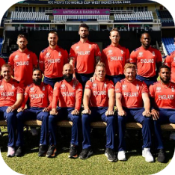
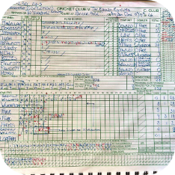


Dataset Summary
Players Data
Matches Data
Teams Data
Deliveries Data
Batting & bowling styles, positions, images. ~500+ players; some missing images or positions.
Seasons 2008–2024 with venue, toss, winner, margin, player_of_match. ~1,000+ records.
15 franchises with IDs, logos, and short names.
Ball-by-ball granular rows (millions) — too large for full processing here but used for derived features like boundaries and six counts.

Slide 3
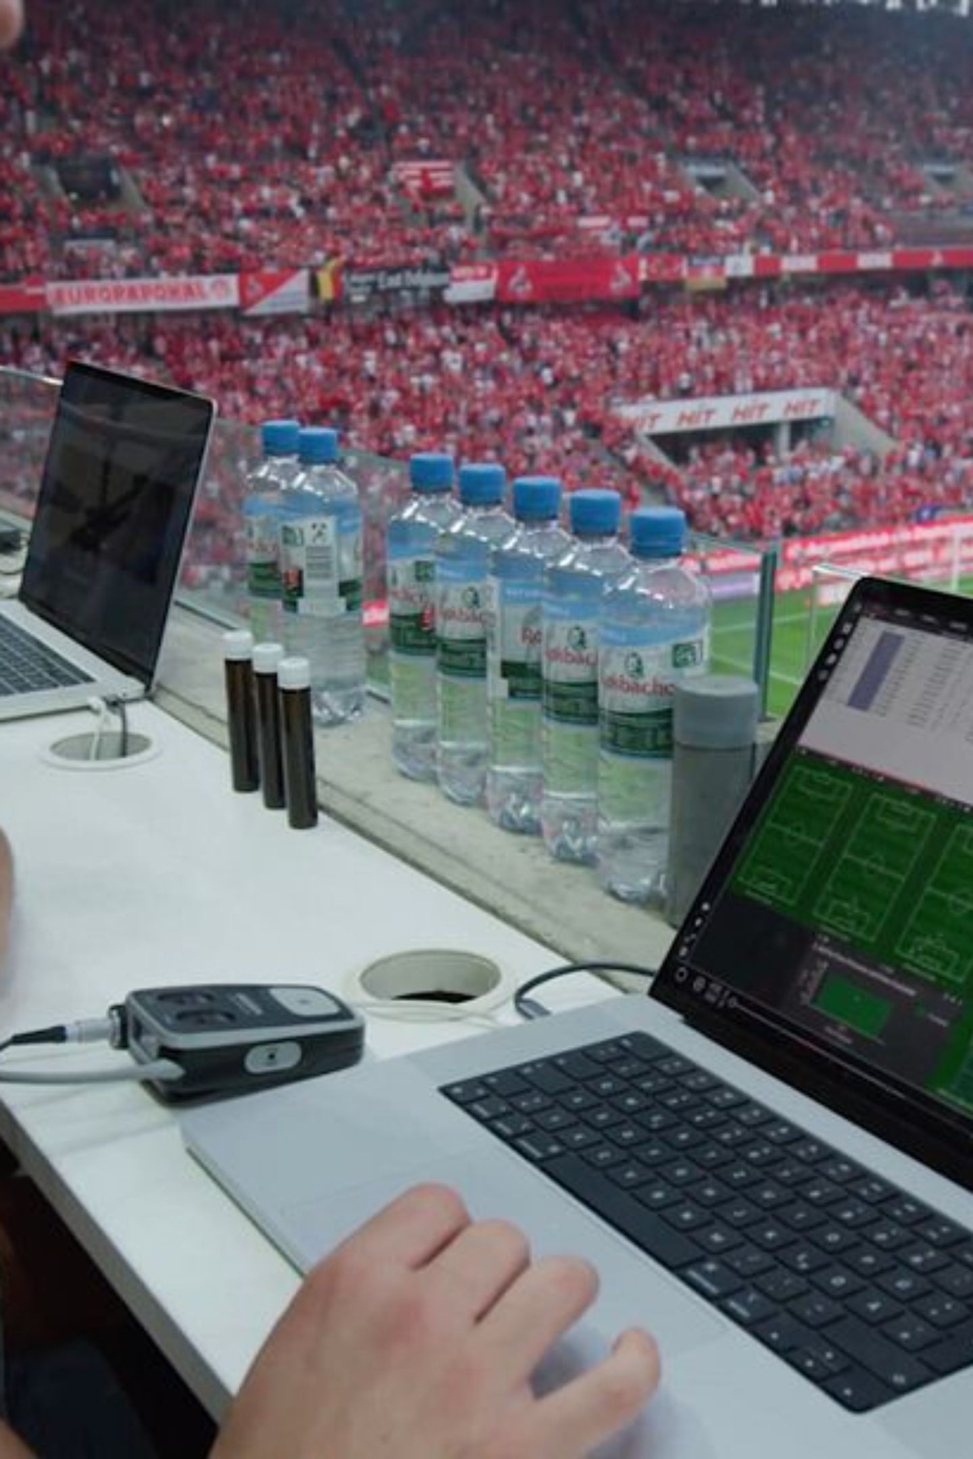
Exploratory Data Analysis — Key Steps
Data inspection: read matches and deliveries with Pandas, explored head(), shape, and info() to understand columns, types, and non-null counts. Missing-value checks (isnull().sum()) found gaps in city, method, player_of_match, winner, result_margin, target_runs/overs; we applied appropriate imputations. Removed duplicate rows (duplicated().sum()) to ensure accurate aggregations. Standardized team names (e.g., Royal Challengers Bangalore → Royal Challengers Bengaluru; Delhi Daredevils → Delhi Capitals) to unify analyses.

Slide 4
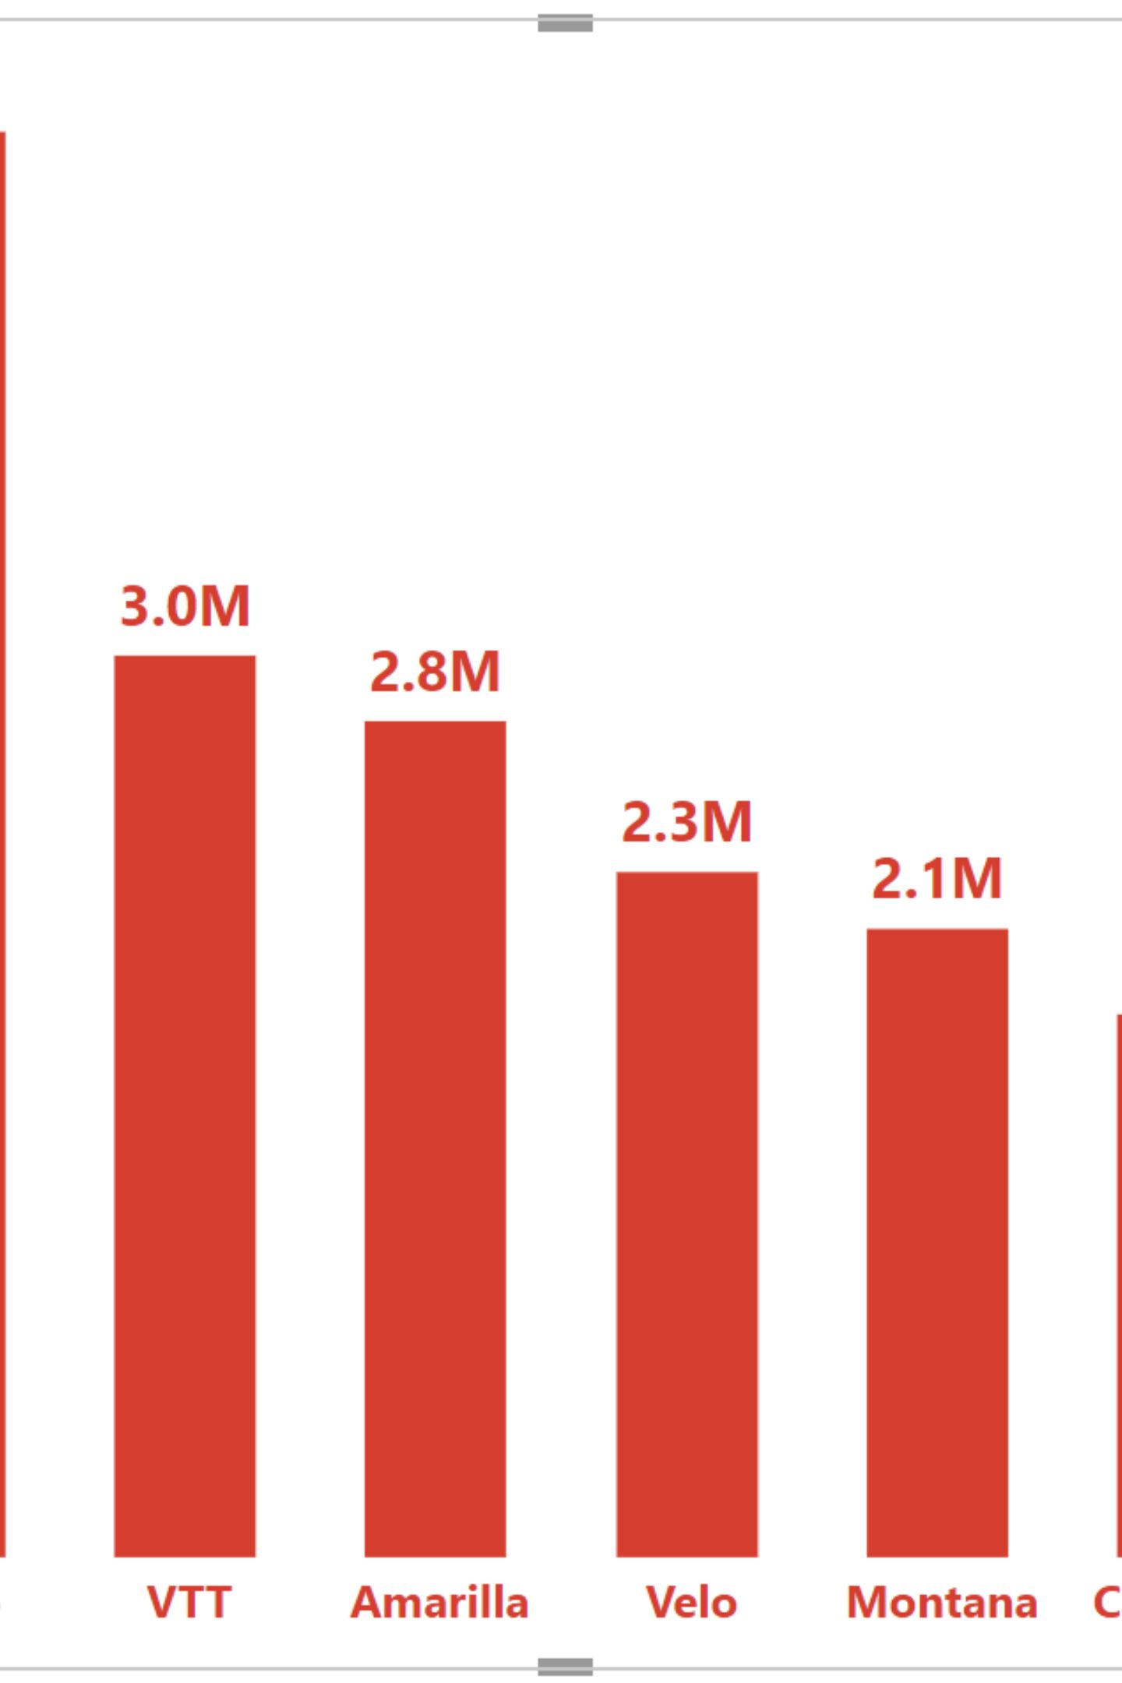
Season & Team-Level Insights
Season Trends
Team Performance
Counted matches per season and visualized season-wise variation — useful to spot structural changes (more teams, more matches in later seasons).
Aggregated wins per team (SQL): Mumbai Indians 144, Chennai Super Kings 138, KKR 131, RCB 123, Delhi Capitals 115, Rajasthan Royals 112, Punjab Kings 112, Sunrisers Hyderabad 88, others lower.
Toss Decisions
Analyzed toss_decision — teams' choice to bat or field after winning toss and its trends over seasons.

Slide 5
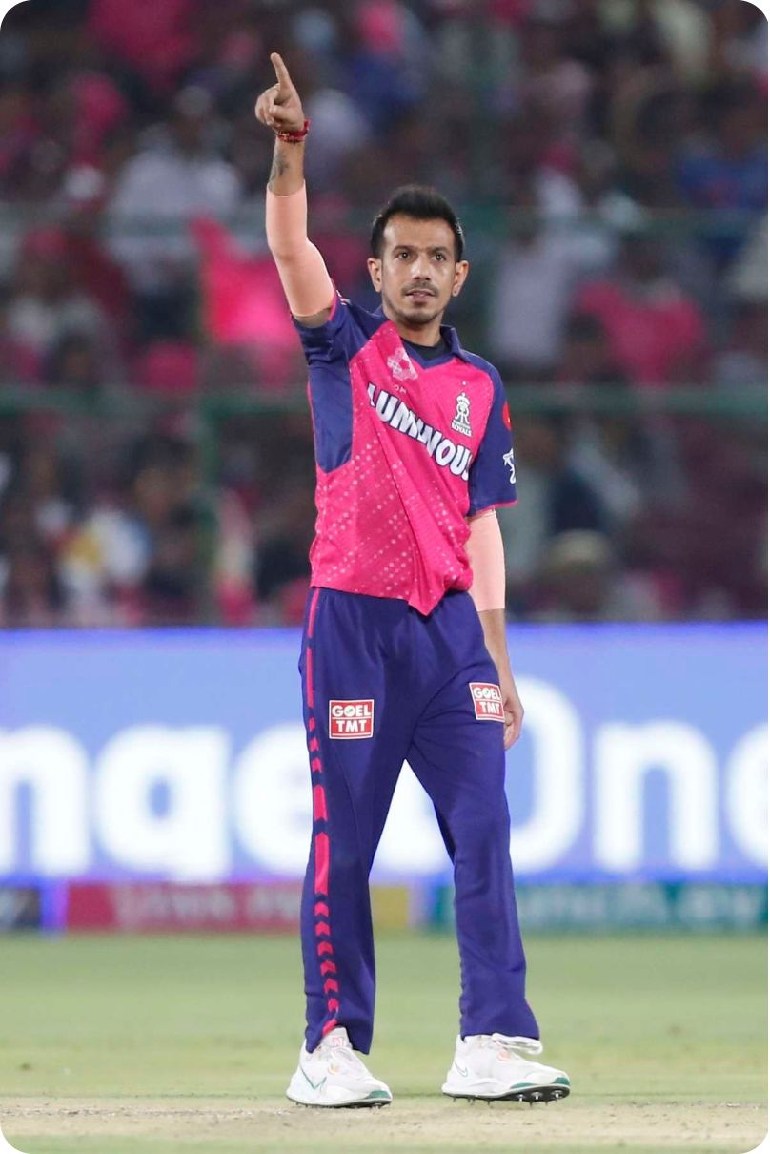
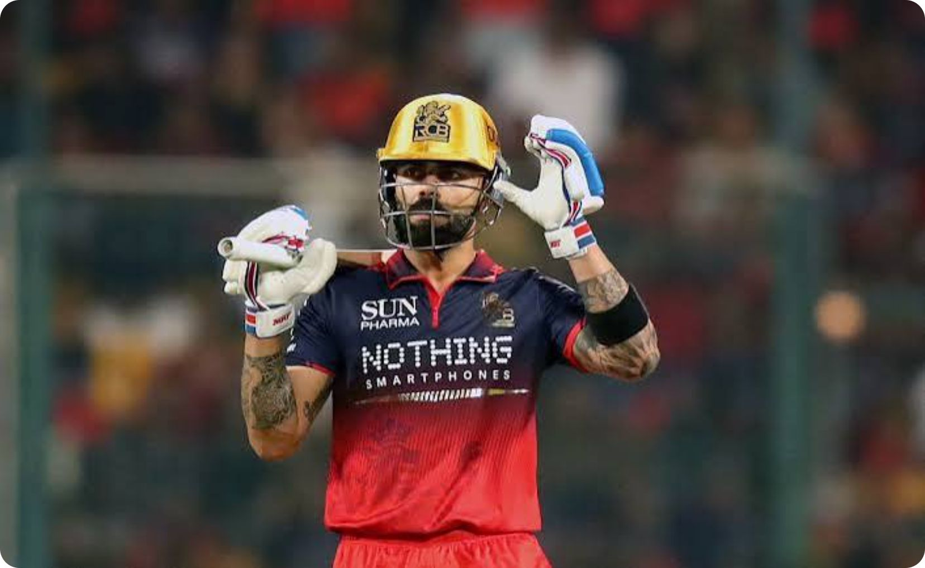
Top Players — Runs & Wickets (SQL Results)
Top Run Scorers
Top Wicket Takers
V Kohli 8014; S Dhawan 6769; RG Sharma 6630; DA Warner 6567; SK Raina 5536; MS Dhoni 5243; AB de Villiers 5181; CH Gayle 4997; RV Uthappa 4954; KD Karthik 4843.
YS Chahal 213; DJ Bravo 207; PP Chawla 201; SP Narine 200; R Ashwin 198; B Kumar 195; SL Malinga 188; A Mishra 183; JJ Bumrah 182; RA Jadeja 169.

Slide 6

Advanced Metrics & Feature Engineering
Created derived features to enrich modeling and dashboards: converted date to datetime and extracted Year, Month, Day. Flagged weekend_match (Sat/Sun). Built toss_match_winner boolean comparing toss_winner and winner. Derived win_type (Bat First vs Chase) from result type. From deliveries, calculated total_boundaries per match (count of 4s and 6s) and mapped by match_id to matches.

Slide 7
SQL Findings: Venues, Scores & Player Awards
Venue Usage
Highest Team Innings
Player of the Match Leaders
Eden Gardens 77, Wankhede 73, M Chinnaswamy 65, Feroz Shah Kotla 60; many others with 20–49 matches.
Top innings include Sunrisers Hyderabad 287 & 277, KKR 272, RCB 263; many 250+ totals noted across seasons.
AB de Villiers 25, CH Gayle 22, RG Sharma 19, V Kohli 18, DA Warner 18, MS Dhoni 17, SR Watson 16, YK Pathan 16, RA Jadeja 16, AD Russell 15.

Slide 8
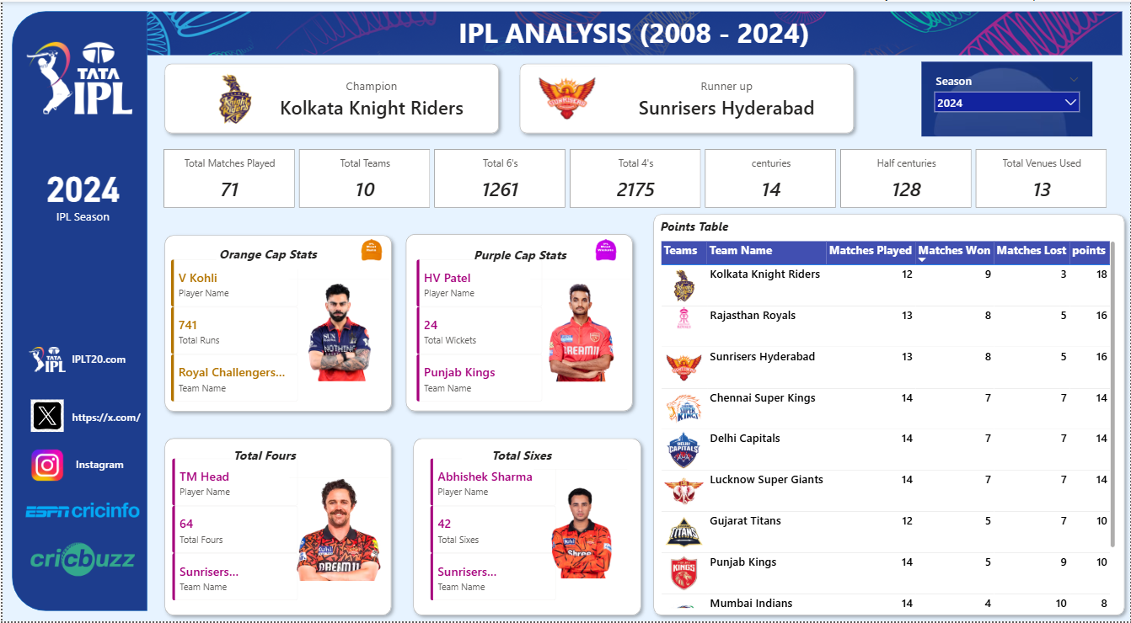
Power BI Dashboard — Interactive Summary (2008–2024)
Built an interactive Power BI dashboard showcasing season filters, KPI cards (matches, teams, total sixes/fours, centuries, half-centuries, venues), Orange Cap and Purple Cap analyses, player-level breakdowns for fours/sixes, and a points table. 2024 snapshot: Champion — Kolkata Knight Riders; Runner-up — Sunrisers Hyderabad; Season matches: 71; Teams: 10; Total sixes: 1,261; Total fours: 2,175; Centuries: 14; Half-centuries: 128; Venues used: 13.

Slide 9
Business & Sports Recommendations
Team Strategy
Player Retention
Focus on toss decision strategies and adapt match plans based on venue and conditions to maximize wins.
Prioritize retaining consistent performers (examples: M.S. Dhoni, Rohit Sharma, Virat Kohli) to stabilize team outcomes.
Fan Engagement
Performance Analytics
Promote marquee rivalries (MI vs CSK), highlight close finishes and high-scoring matches in marketing to boost viewership.
Leverage ball-by-ball data to identify clutch performers and inform selection, match tactics, and training focus.

Slide 10

Conclusion & Tools Used
This analysis covered a full analytics workflow: data preprocessing and feature engineering in Python (Pandas & Jupyter), structured aggregations and rankings in SQL, and visual storytelling in Power BI. Key takeaways: MI and CSK remain dominant historically; toss decisions materially impact outcomes; batting aggression increased after 2015; star players strongly influence match results. These insights can guide franchises, analysts, and fans toward data-driven decisions.
Python / Pandas
Preprocessing, missing-value handling, feature engineering, EDA.
SQL
Aggregations, rankings, venue and player leaderboards (CTEs for batter_runs).
Power BI
Interactive dashboard with season filters, KPI cards, Orange/Purple Cap, player visuals, and points table.

Slide 11


Official Sources
https://github.com/abhijitbhoi45-sketch/customer_behavior_analysis
www.linkedin.com/in/

